Slide 1




Agile → DevOps → MLOps
16010123012- Aaryan Sharma
16010123017- Aditey Kshirsagar
16010123023- Aditya Baheti
1

Slide 2
The Problem
Traditional software development models like Waterfall were rigid and time-consuming.
Feedback was received only at the end of the process, leading to major delays and costly rework.
As technology advanced, teams needed methods that were faster, more flexible, and more responsive to change.
2

Slide 3
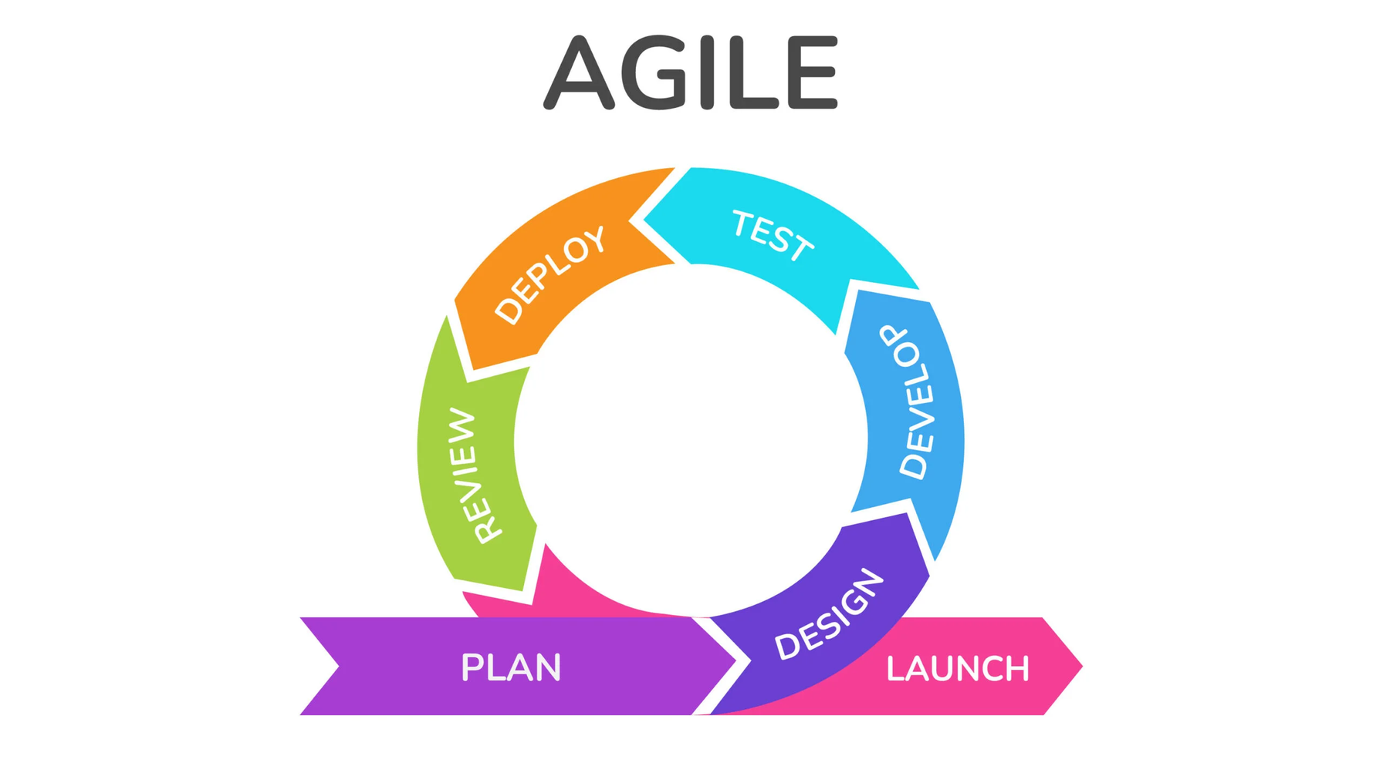
Agile Development
Agile introduced short development cycles called sprints, allowing quick delivery of working software.
It encouraged close collaboration between teams and customers to ensure continuous improvement.
The approach made it possible to adapt rapidly to changing requirements and user needs.
3

Slide 4
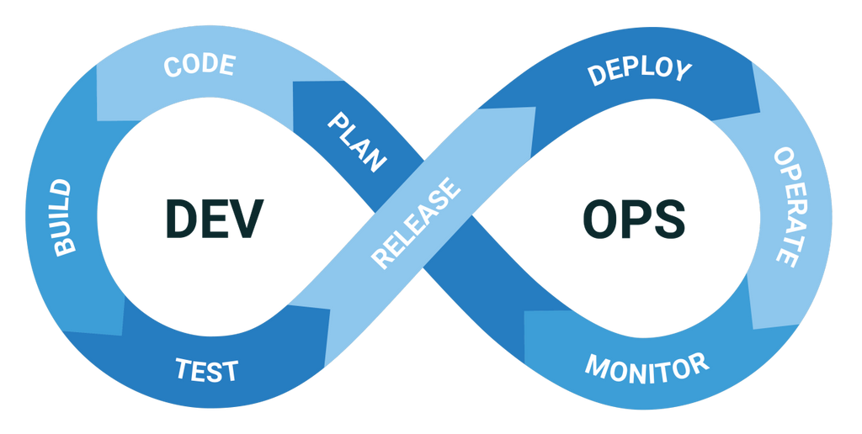
DevOps: Bridging the Gap
DevOps evolved to integrate development and operations teams, breaking down silos within organizations.
It focuses on automation, continuous integration, and continuous delivery for faster deployment.
DevOps ensures seamless collaboration between teams, improving product stability and reducing release times.
4

Slide 5
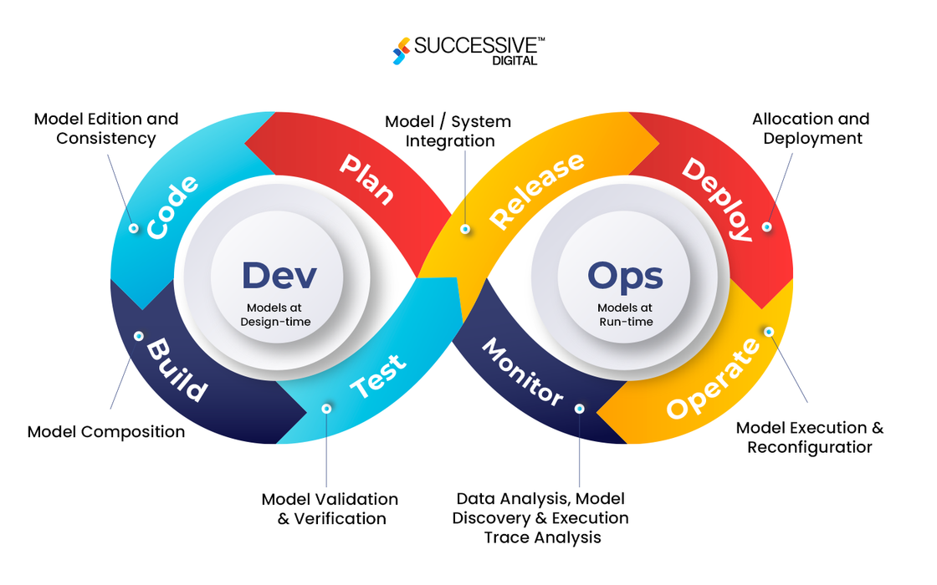
Inside DevOps
DevOps evolved to integrate development and operations teams, breaking down silos within organizations.
It focuses on automation, continuous integration, and continuous delivery for faster deployment.
DevOps ensures seamless collaboration between teams, improving product stability and reducing release times.
5

Slide 6
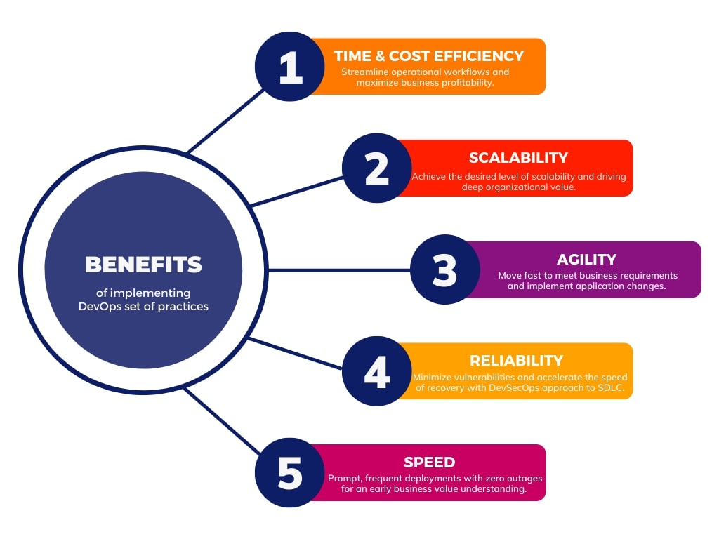
Impact of DevOps
Before DevOps, software deployment was manual, slow, and prone to errors.
With DevOps, automation replaced manual processes, resulting in faster and more reliable releases.
Teams now deploy updates frequently and respond to issues more effectively, improving overall quality.
6

Slide 7
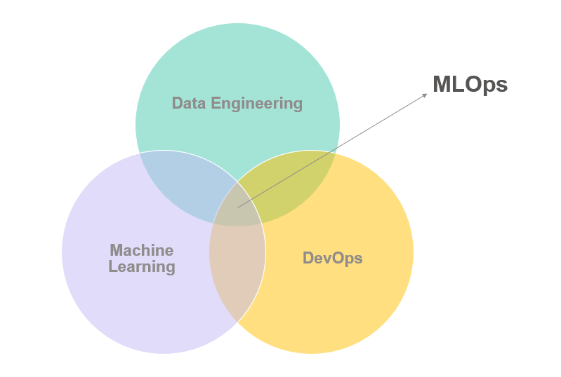
The Rise of MLOps
As machine learning gained importance, MLOps extended DevOps principles to data and model management.
It automates the entire machine learning lifecycle, including data preparation, model training, and deployment.
MLOps ensures that machine learning models remain accurate, scalable, and continuously updated.
7

Slide 8
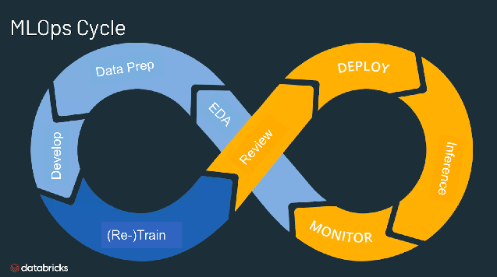
The MLOps Lifecycle
The MLOps process begins with data collection and preprocessing.
Models are then trained, validated, and deployed into production environments.
After deployment, performance is continuously monitored, and models are retrained when necessary to maintain accuracy.
8

Slide 9
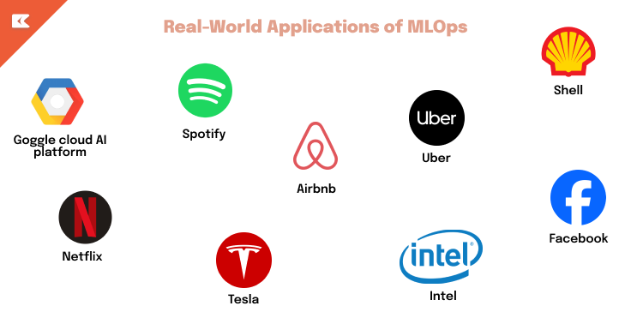
Real-World Applications
Netflix applies MLOps to refine its recommendation engine through constant learning.
Amazon uses MLOps for demand forecasting and inventory optimization.
Tesla employs MLOps to update and improve its self-driving algorithms with real-time data.
10

Slide 10
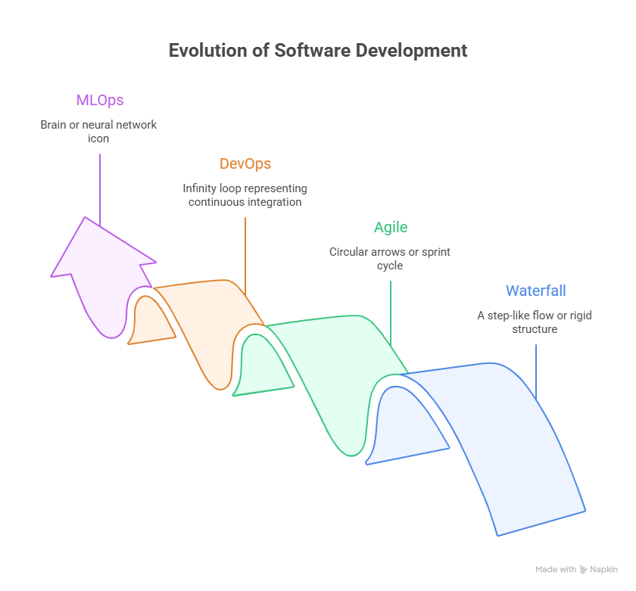
The Evolution Timeline
11

Slide 11
Conclusion
The journey from Agile to DevOps to MLOps shows how software engineering continues to evolve.
Agile delivered speed, DevOps delivered efficiency, and MLOps delivers intelligence.
These methods will continue to shape the future of innovation and automation in technology.
12

Slide 12
References
Pressman, Roger S. Software Engineering: A Practitioner’s Approach, 8th Edition, McGraw-Hill, 2015.
https://www.databricks.com/glossary/mlops
https://successive.tech/blog/devops-in-modern-software-development/
https://www.geeksforgeeks.org/software-testing/what-is-agile-methodology/
Lucidchart - https://www.lucidchart.com
13

Slide 13
Thank You
14

